Slide 1
Chapter 9
Morphological Image Processing
By. Mohamed S. Bayomi

Slide 2
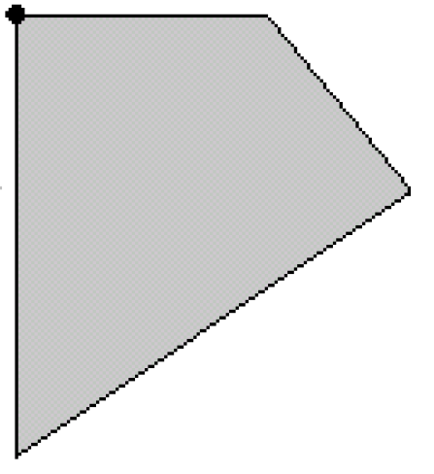
Mirroring of an object
In asymmetric structure elements we don’t use the original structure element we mirror it around it’s origin.

Slide 3
Mirroring of an object

Slide 4
Mirroring of an object
This is the structure element will be used.

Slide 5

Mirroring of an object
In symmetric structure elements it will not matter to mirror or not.

Slide 6




We have 2 main morphological operations
Dilation Erosion
The rule is:
if the structure element has at least one pixel of binary 1, the origin will be 1
The rule is:
if the structure element has at least one pixel of binary 0, the origin will be 0. The structure element should be totally contained inside the body to give 1 at the origin.

Slide 7


For simplicity we imagine a moving origin on the boundary of the body and the whole structure element to be changed
Dilation Erosion
The rule is:
The origin moves on boundary and the structure element draw ones.
The rule is:
The origin moves on boundary and the structure element draw zeros.

Slide 8
Dilating point → structure element
Eroding a body with an structure element of the same shape → point
Dilation Erosion

Slide 9

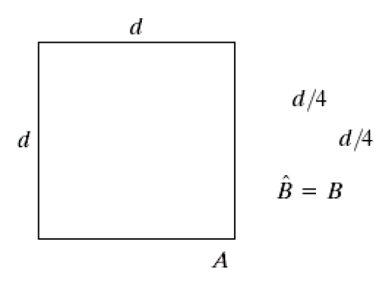
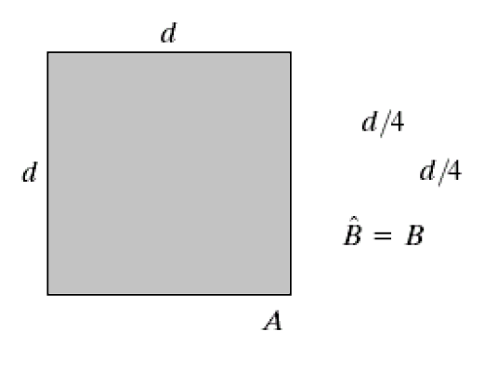
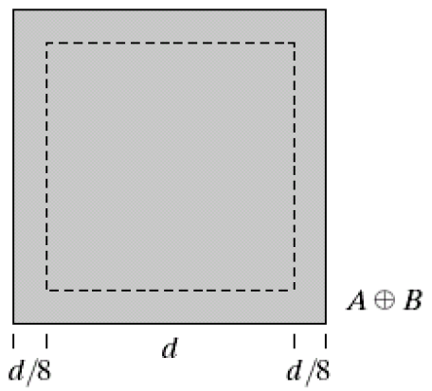

Dilate
Object Structure
Element
Mirroring of Symmetric object, gives the same object.

Slide 10
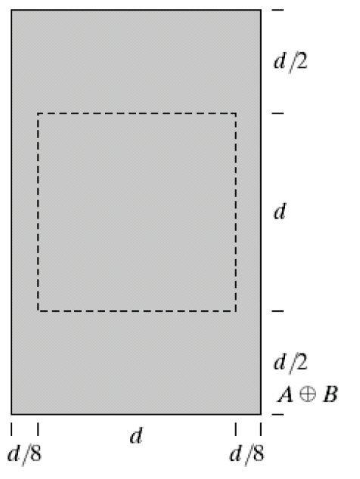
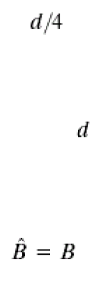

Dilate
  Structure
Object Element
Mirroring of Symmetric object, gives the same object.

Slide 11

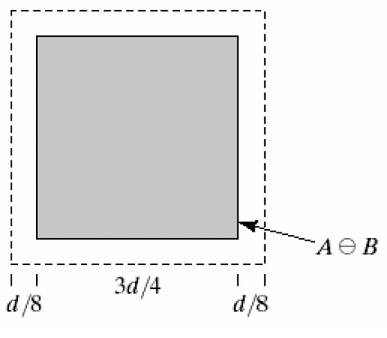
Erode
Object Structure
Element
Mirroring of Symmetric object, gives the same object.

Slide 12
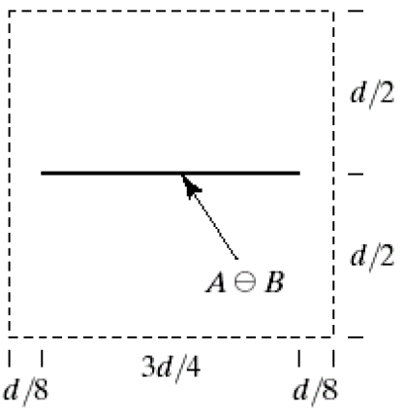
Erode
  Structure
Object Element
Mirroring of Symmetric object, gives the same object.

Slide 13
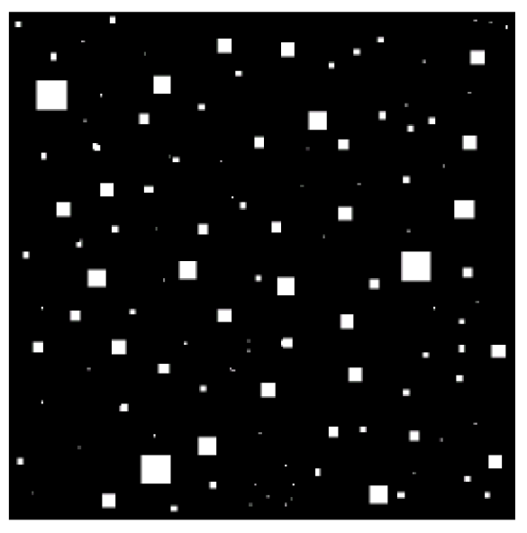



Find object of size 15 “max size”
1- erode by structure element 15, will give pixel 1 at the origin of objects 15, and zero otherwise.

Slide 14
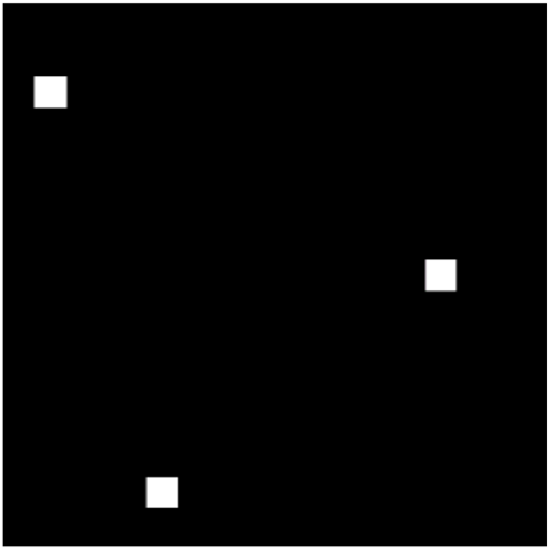
Find object of size 15 “max size”
2- dilate by structure element 15, will retrieve the objects of size 15.

Slide 15
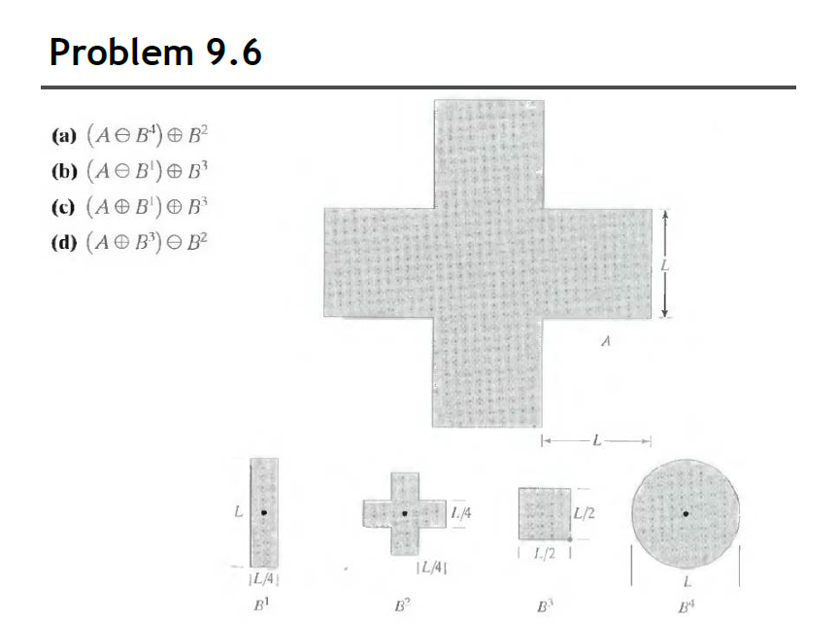
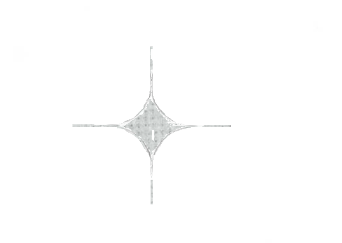
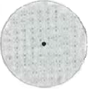
_______

Slide 16
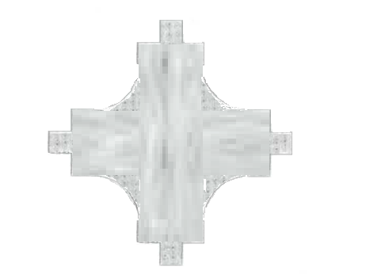

____

Slide 17


Open and Close
Open:
Erode first then Dilate.
Close:
Dilate first then Erode.

Slide 18
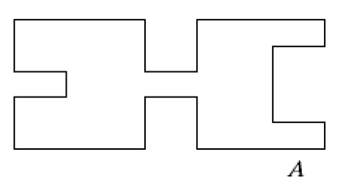
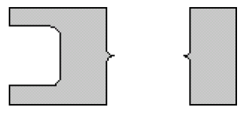

open
1- Erode

Slide 19
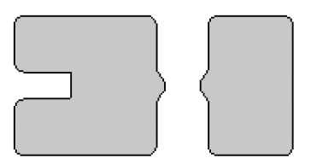
open
2- Dilate

Slide 20
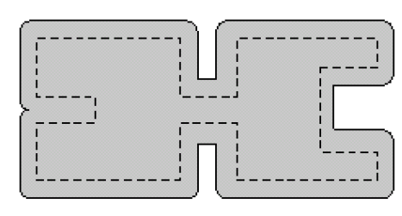
Close
1- Dilate

Slide 21
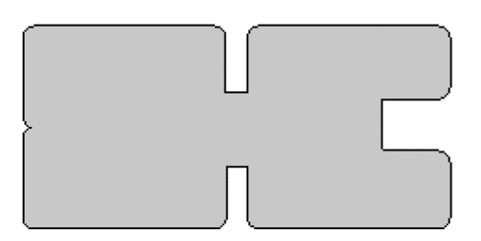
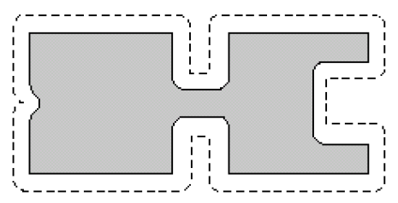
Close
2- Erode

Slide 22
Hit or Miss
We want to identify specific object.
Make a structure element with the same shape of the required object,
Erode the image with the structure element,
The required object and bigger will be replaced by 1 pixel at the origin.
Complement the image , complement the structure element,
Erode the inverted image with the inverted structure element.

Slide 23
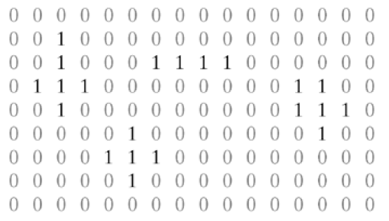
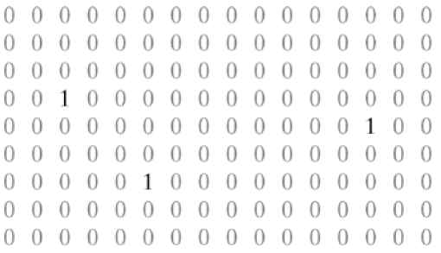
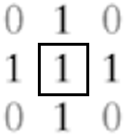
Image
Hit or Miss
Output No.1
Structure element
a
×
a
We want elements of cross of ones with 4 zeros at the corners not this

Slide 24
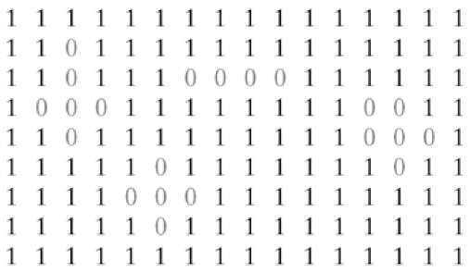
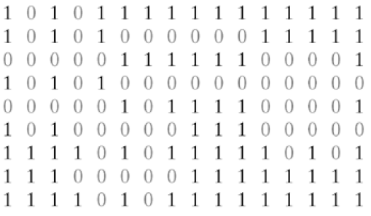
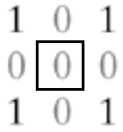
Image complement
Hit or Miss
Here we will check the 4 zeros at the corners
Image
Structure element
a
a
×
a
Structure element
complement
a
a
Output No.2

Slide 25
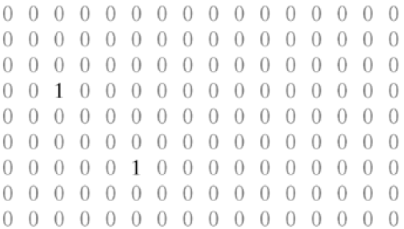
Hit or Miss
Anding the 2 output images
a
a

Slide 26
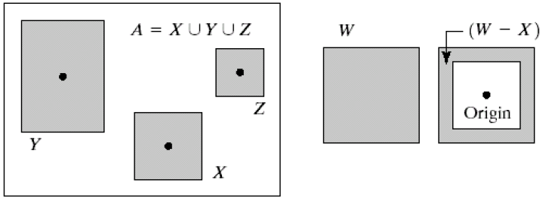
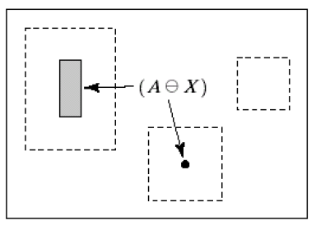
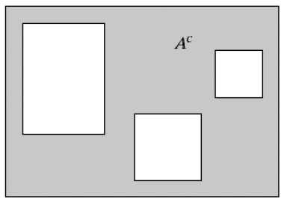
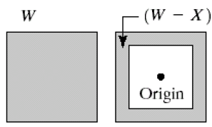
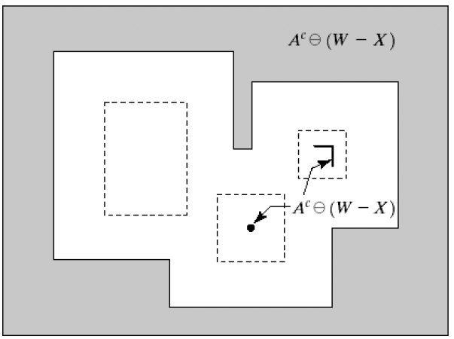
Hit or Miss
Find X
Erode by X
Complement
Erode by (W-X)
W is one pixel bigger than X in all directions

Slide 27
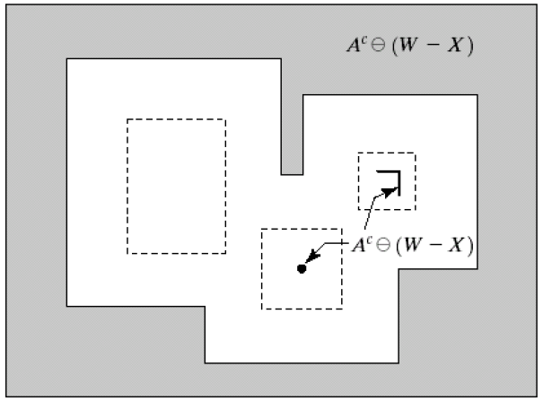
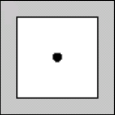
Hit or Miss
While eroding Z the structure element hit the gap of X creating the L shape

Slide 28
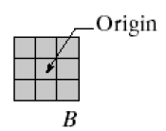
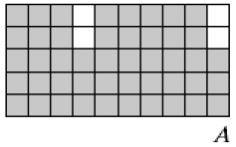
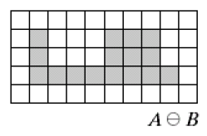
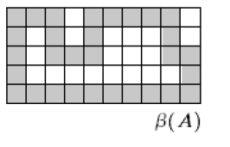
Boundary Extraction
Eroding an object by small structure element then substitute the original image – the result of erosion will give you the boundary of the object.
Erode by B
Anded with complement of the result of the prev. step

Slide 29
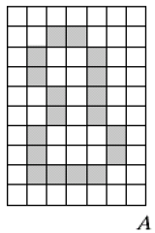
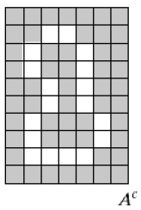
Region Filling
It needs many iterations to be done.
Starting by point inside the region, dilate with cross structure element (+) , And the output with the complement of original image.
Starting point
Complement

Slide 30
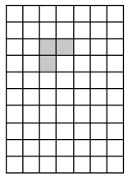
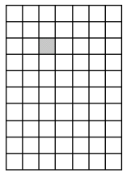
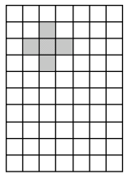
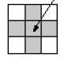
Anding
Dilate

Slide 31
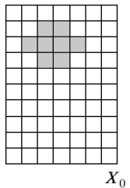
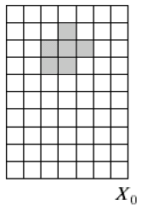
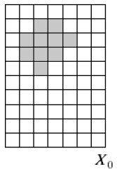
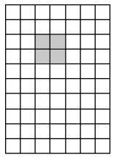
Anding
Dilate

Slide 32
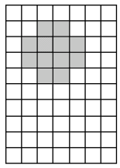
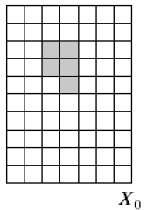

Anding
Dilate

Slide 33


Anding
Dilate

Slide 34


Anding
Dilate

Slide 35


Anding
Dilate

Slide 36


Anding
Dilate

Slide 37

Anding
Dilate
The last 2 iterations are the same → stop

Slide 38


The Result is the union of the region fill and the boundary

Slide 39



Extraction of Connected Component
It needs many iterations to be done.
Starting by point inside the component, dilate with square structure element , And the output with the original image.
Select a starting point on the component

Slide 40




Extraction of Connected Component
Anding
Dilate

Slide 41


Extraction of Connected Component
Anding
Dilate

Slide 42

Extraction of Connected Component
After many iterations we will get this shape

Slide 43
Extraction of Connected Component
By dilating this shape then anding this shape with the original image we will get the same shape.
The last 2 iterations are the same → stop

Slide 44


Fully contained will not erase

Slide 45
Not fully contained

Slide 46


Not fully contained

Slide 47
Not fully contained

Slide 48


Slide 49


(c) Only Non overlapping particles:
Hit or miss

Slide 50



(a) Only of particles that have merged with boundary of the image
1- make a boundary of the image.
2- And the image with the boundary.
3- Extract Connected Component by expansion starting with this seed.

Slide 51

(b) Only Overlapped particles:
Original Image – the 2 previous results , such that the image only contain 3 types of particles:
Overlapped.
non overlapped.
On boundary.

Slide 52
Thanks

